Slide 1
APUSH Review: The French And Indian (7 Years) War
Everything You Need to Know About The French And Indian War To Succeed In APUSH

Slide 2
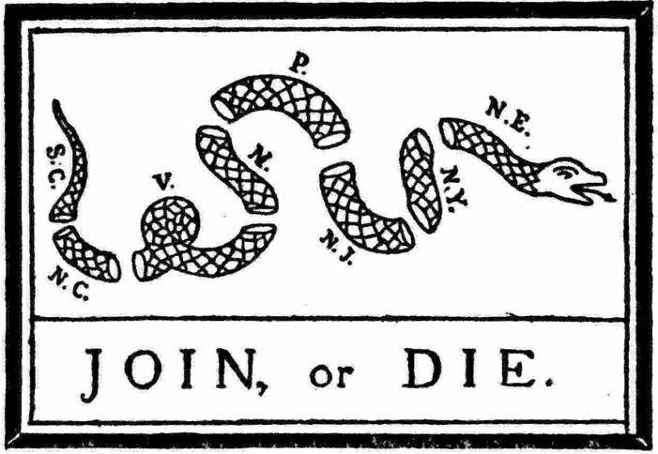
Key Ideas Before the War
Albany Plan of Union(1754):
Purpose was to negotiate a treaty between Iroquois and the British
Significance:
“Join or Die”
COLONIAL UNITY!!!
Did it pass?
Delegates of convention passed it, colonies and Britain rejected it. Why?
Increase taxes by colonists
Colonies didn’t want to surrender control
Salutary Neglect:
Britain left colonies develop on their own, so long as they were profitable

Slide 3
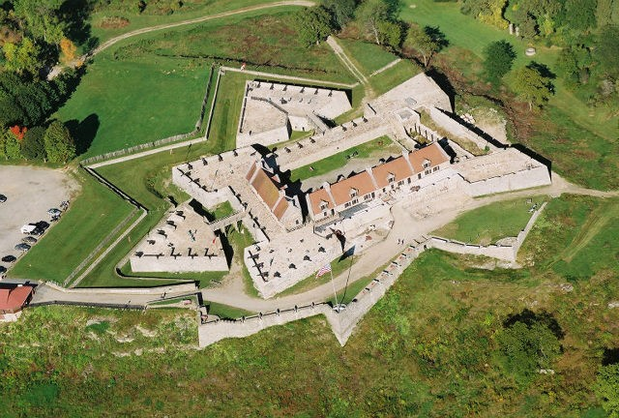
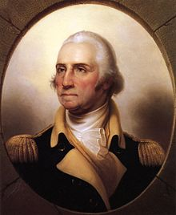

The War
Causes:
Started in 1754
George Washington sent to challenge French expansion
Lasted from 1754 - 1763
The F & I War was part of a larger conflict, 7 Years War
Most Natives (except Iroquois) sided with the French
British forcibly enlisted colonists (impressment) and forced colonists to provide shelter (quarter)

Slide 4
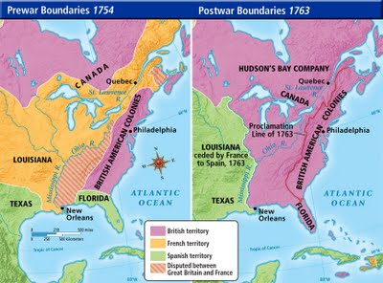
Peace of Paris, 1763
Britain gained all French land east of Mississippi River, save New Orleans
French gave NO and land west of Mississippi to the Spanish

Slide 5
Big Ideas After the War
Balance of Power shifts in North America
Native Americans lose a partner in France
Tensions increase between Britain and colonists
Britain feels the colonies should share in the responsibility of the empire
The colonists will wish to go back to Salutary Neglect

Slide 6

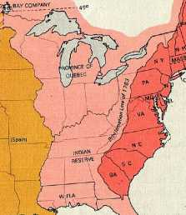
Political Impacts of the War
Salutary Neglect ENDS!
Britain now takes a hands on approach to governing colonies
King George III and new PM George Grenville
Proclamation Line of 1763
Hoped to avoid conflict between colonists and Natives
British troops were stationed on the border
Colonists resent not being allowed to expand
Colonial Resistance to the British Policies
Sons of Liberty
Smuggling
Writs of Assistance, Admirality Courts

Slide 7

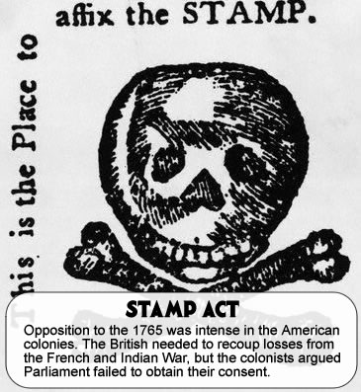
Economic Impacts of the War
Britain is in debt
Colonists contributed little financially, Britain began to tax the colonists and strictly enforce those taxes
End of salutary neglect
Currency Act
Stamp Act
Stamp Act Congress
Boycotting of British Goods
Declaratory Act
“No Taxation Without Representation”

Slide 8
Social Impacts of War
Colonial soldiers viewed themselves as equals with British soldiers, not vice versa
British viewed colonial soldiers as inadequate
George Washington only promoted so far
Emergence of a colonial identity
Colonial Unity AGAINST the British
Stamp Act Congress

Slide 9
Past Essay Topics
2004 DBQ: In what ways did the French and Indian War (1754-63) alter the political, economic and ideological relations between Britain and its American colonies?
2012 Free Response: Analyze the effect of the French and Indian War and its aftermath on the relationship between Great Britain and the British colonies. Confine your response to the period from 1754 to 1776

Slide 10
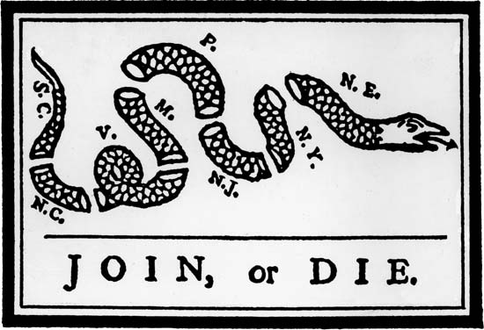
Thanks for watching!
Subscribe to APUSHReview.com
Help spread the word
Questions? Comments? Ideas for videos?
Leave in comments
SUBSCRIBE, and SUCEED.

